Slide 1
Unit 8: Content
System Development method: SSM – chapter 25 – pp 507-516
Philosophical approach: System Theory – chapter 4 – pp 51-78
Techniques: Rich pictures, Root definitions & Conceptual Models – chapter 10 – pp 199-213
D de Villiers : 2rd September 2013

Slide 2
Chapter 25
Organizational-Oriented
Methodologies

Slide 3
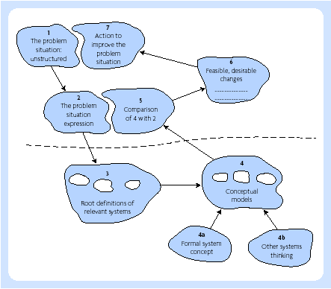
SSM in summary

Slide 4
SSM stages
The problem situation: unstructured
The problem situation: structured
Root definition of relevant systems
Building conceptual models
Comparing conceptual models with reality
Assessing feasible and desirable changes
Action to improve problem situation

Slide 5
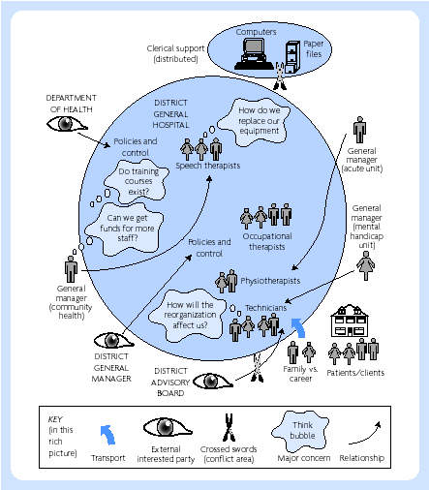
Rich picture diagram – paramedical services

Slide 6
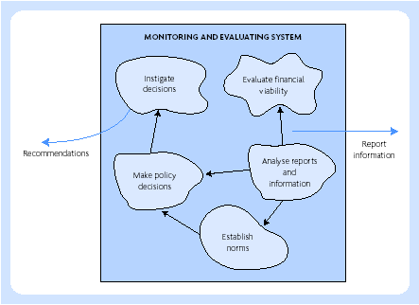
Conceptual model – monitoring and evalution system for community health

Slide 7
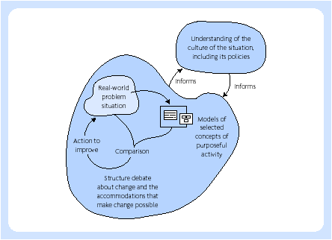
Model 2 SSM

Slide 8
MODE2 SSM
Finding out about a problem situation, including culturally/politically.
Formulating some relevant purposeful activity models.
Debating the situation, using the models, seeking from that debate both (a) changes which would improve the situation and are regarded as both desirable and (culturally) feasible, and (b) the accommodations between conflicting interests which will enable action-to-improve to be taken.
Taking action in the situation to bring about improvement.

Slide 9
Chapter 4
Organisational
Themes

Slide 10
Systems thinking
System
Boundary
Environment
Open systems
Purpose
Soft systems

Slide 11
Information systems strategy
Efficiency
Cost-benefit
Competitive advantage
Effectiveness
  Redefine the boundaries of particular industries
  Develop new products or services
  Change the relationships between suppliers and customers
  Establish barriers to deter new entrants to marketplaces

Slide 12
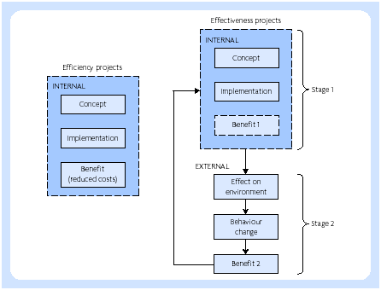
Benefit realisation

Slide 13
Chapter 10
Holistic Techniques

Slide 14
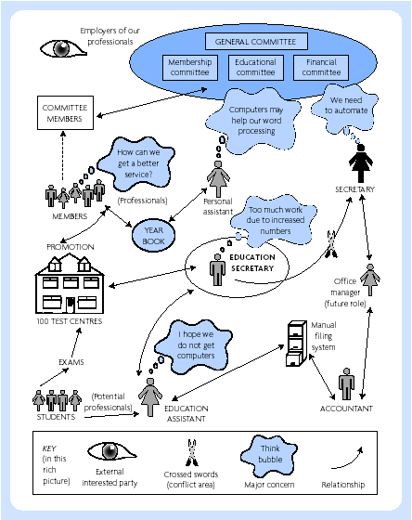
Rich pictures

Slide 15
Root definitions - CATWOE
Client is the ‘whom’ (the beneficiary, or victim, affected by the activities)
Actor is the ‘who’ (the agent of change, who carries out the transformation process)
Transformation is the ‘what’ (the change taking place, the ‘core of the root definition’)
Weltanschauung (or world view) is the ‘assumptions’ (the outlook which makes the root definition meaningful)
Owner is the ‘answerable’ (the sponsor or controller)
Environment remains the ‘environment’ (the wider system of which the problem situation is a part)

Slide 16
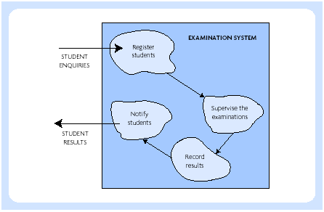
Conceptual model – Level 1

Slide 17
Conceptual models from root definitions
1. Form an impression of the system to carry out a physical or abstract transformation from the root definition.
2. Assemble a small number of verbs that describe the most fundamental activities in the defined system.
3. Develop this by deciding on what the system has to do, how it would accomplish the requirement, and how it would be monitored and controlled.
4. Structure similar activities in groups together.
5. Use arrows to join the activities which are logically connected to each other by information, energy, material, or other dependency.
6. Verify the model by comparing it against the perceived reality of the problem situation.

Slide 18
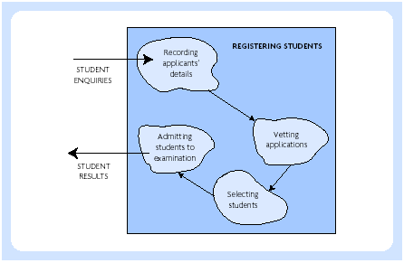
Conceptual model – Level 2

